Slide 1

Group No: - C18
A
seminar on
“Driver Yawning Analysis using Pi Camera and Deep Learning”
Guide :-
Ms. S. M. Ingawale
Co-Guide :-
Ms. N. Y. Patole
Presented By:-
Chetan Narendra Thorat
Neha Rajesh Patil
Abhishek Sharad Phapale
Roll no.
E43052
E43053
E43054
Department of Electronics & Telecommunication Engineering
Smt. Kashibai Navale College of Engineering, Pune - 41.

Slide 2
AIM
Design a drowsiness detection system is to aid in the prevention of accidents passenger and commercial vehicles.

Slide 3
OBJECTIVES
To detect the early symptoms of drowsiness before the driver has fully lost all attentiveness and warn the driver that they are no longer capable of operating the vehicle safely.
To design a system that use eyes closure and yawning as a way to detect fatigue and drowsiness.
To reduces the accident percentage.

Slide 4
CONTENTS
Abstract
Introduction
Literature Survey
Block Diagram and Description
Hardware and Software Design
Simulation Result
Advantages, Disadvantages and Applications
Conclusions
9. Future Scope
10. Phase Wise Plan
11. References

Slide 5
ABSTRACT
Drowsiness and fatigue are one of the main causes leading to road accidents. A method is developed to detect driver’s eyes closure and yawning for drowsiness analysis by PI camera. The driver face monitoring system is a real-time system that investigates the driver physical based on the processing of driver face images .This system analyses by the various techniques and procedures like Open CV and Deep Learning Algorithm is used in the system for detecting driver’s fatigue and yawning.

Slide 6
INTRODUCTION
Drowsy driving is a significant problem leading to fatal accidents.
A system to alert drivers when they are drowsy is necessary to prevent accidents.
The proposed system analyzes the driver's eyes and mouth to detect signs of drowsiness.
The system uses a camera to monitor the driver's eyes and mouth.

Slide 7
CONTINUED…..
So this system will alert them if they fell asleep while driving. This system is independent of the subject so it can be employed in commercial systems.
Machine learning algorithms analyze the data to determine if the driver is becoming drowsy.
It tracks changes in facial expressions, such as drooping eyelids and yawning.

Slide 8
CONTINUED...
Drowsiness detection technology is an essential component of safe driving.
The proposed system provides a reliable way to prevent accidents caused by drowsy driving.
The eye closure can be detected by analyzing the eye aspect ratio and the yawing can be detected by analyzing the mouth aspect ratio (MAR). The EAR and MAR threshold is set.

Slide 9
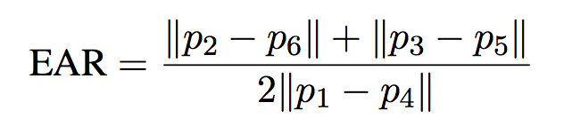
INTRODUCTION
System detects the early signs of fatigue if there is any change in these values.
If the value of EAR keeps decreasing it means that the driver is closing his eyes and if the MAR value increases it means the driver is yawing.
Implement this logic to detect the driver’s fatigue in this system.

Slide 10
BACKGROUND
Each year, there is an increase in road accidents cases involving cars and heavy vehicles like buses, lorries and trucks in Malaysia.
Drowsiness and fatigue condition is one of the prime factors contributing to road accidents.
Driving in this condition may result terrible causes since it affects the driver’s judgment and concentration.

Slide 11
PROBLEM STATEMENT
Fatigue, in general, is very difficult to measure or observe unlike alcohol and drugs, which have clear key indicators and tests that are available easily.
Probably, the best solutions to this problem are awareness about fatigue-related accidents and promoting drivers to admit fatigue when needed.

Slide 12
LITERATURE SURVEY
No | Paper Topic | Author | Technology Uesd
1. | Driver Drowsiness Detection By Using Webcam”. | Pooja D.C.1, | Open CV
2. | Driver Drowsiness Detection System Based on Visual Features”,2018. | Fouzia et al. | Image Processing
3. | Real-Time Driver Drowsiness Detection using Computer Vision,2021. | Mahek Jain, | Using Haarcascade classifier eyes and mouth movements are tracked.
4. | Drowsy Driving Detection System IOT Perspective,2020. | Tejashwini N et al. | Computer vision, Python , Pi camera module.

Slide 13
LITERATURE SURVEY
No | Paper Topic | Author | Technology Used
5. | A Method of Driver’s Eyes Closure and Yawning Detection for Drowsiness Analysis by Infrared Camera” (2019),IEEE | Wisaroot Tipprasert | ROT Techniques:-to find targets as eye and mouth. Infrared 2D camera to capture face image
6. | Driver Drawsiness Detection System Using Haarcascade Algorithm, 2022 | Adnan Shaikh et al. | Haarcacade Algorithm
7. | Automated Driver Drowsiness Detection For Non 2 Wheelers,2019-2020 | Sangivalasa et al. | Haarcacade Algorithm
8. | A Survey on State-of-the-Art Drowsiness Detection Techniques,2019. | Muhamad Razman et al. | Digital Image Processing

Slide 14
LITERATURE SURVEY
No | Paper Topic | Author | Technology Uesd
9. | A Drowsy Driver Detection System for Heavy Vehicles. | R. Grace, V. E. Byrne, D. M. Bierman, J.-M. Legrand, D. Gricourt, B. Davis | Perclos Camera System
10. | Real-Time Drowsiness Detection System using Dlib”, 2019 5th IEEE International WIE Conference on Electrical and Computer Engineering, 15-16 Nov 2019, Bangalore, India | Shruti Mohanty et al. | Dlib’s HOG Algorithm

Slide 15
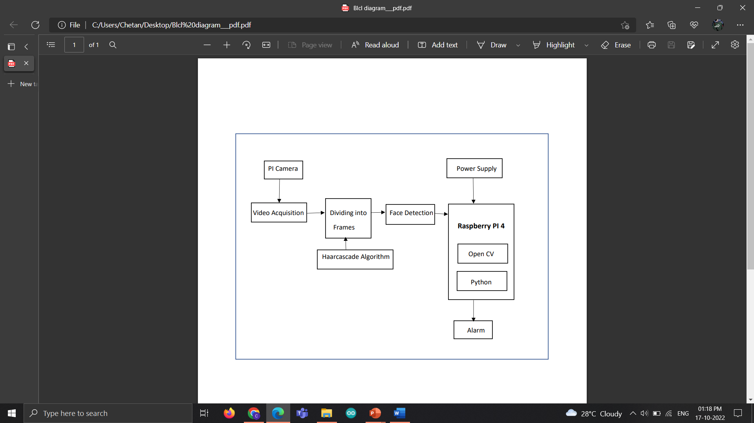
BLOCK DIAGRAM
Fig. 1: Block Diagram of Yawning and Drowsiness Detection

Slide 16
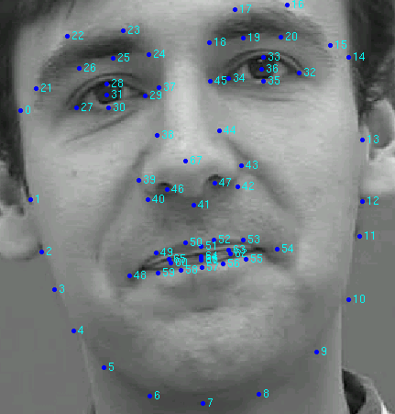
BLOCK DIAGRAM DESCRIPTION
Above figure showcases the various important blocks in the proposed system and their high-level interaction. It can be seen that the system consists of 5 distinct modules namely,
(a) Video acquisition,
(b) Dividing into frames,
(c) Face detection,
(d) Eye detection and,
(e) Drowsiness detection. Fig. 2: D-lib Landmarks

Slide 17
CONTINUED…….
The functionality of each these modules in the system can be described as follows:
a)Video acquisition: Video acquisition mainly involves obtaining the live video feed of the automobile driver. Video acquisition is achieved, by making use of a PI camera.
b)Dividing into frames: This module is used to take live video as its input and convert it into a series of frames/ images, which are then processed.

Slide 18
CONTINUED…….
c)Face detection: The face detection function takes one frame at a time from the frames provided by the frame grabber.
Every frame it tries to detect the face of the automobile driver. This is achieved by making use of Deep Learning.
d)Eyes detection: Once the face detection function has detected the face of the automobile driver, the eyes detection function tries to detect the automobile driver's eyes.

Slide 19
CONTINUED…….
Pi Camera: Raspberry Pi camera Module, supports its Night Vision. This Camera can Adjustable-Focus.
Supports all revisions of the Pi 5 megapixel. It get person face as a input, gives output as a alarm.
Deploy on Raspberry Pi: Deploy on Raspberry Pi using an external monitor and connect Pi camera and a buzzer to make it a complete detection system.

Slide 20
TECHNICAL SPECIFICATION OF PROJECT
Hardware Specification:-
a) Raspberry PI 4+
b) 4 GB Memory Card
c) Pi Camera
d) Buzzer
Software Specification:-
a) Android Studio Code
b) Python
c) Pi OS
d) Deep Learning Algorithm

Slide 21
IMPLEMENTATION
1. Hardware Setup
Mounting the Pi camera on the dashboard.
Connecting the Pi camera, buzzer, and LCD screen to the Raspberry Pi.
2. Software Setup
Installing necessary software such as Python and OpenCV..
Writing a Python script to detect yawning and eye blinking

Slide 22
CONTINUED…….
3. Real-time Acquisition System
Setting up a real-time acquisition system using OpenCV or dedicated video capture hardware.
4. Driver Monitoring
Configuring the buzzer and LCD screen to sound an alarm and display a warning message.
Testing the system using a simulated driver yawning and blinking.

Slide 23
CONTINUED…….
5. Pilot Study
Conducting a pilot study to evaluate the system's performance.
Collecting data on driver yawning and eye blinking behavior during a set period of time.
6. Performance Evaluation
Analyzing the data collected from the pilot study..
Assessing the system's performance using metrics such as sensitivity, specificity, accuracy, and response time

Slide 24
CONTINUED…….
7.Testing and Optimization
Conducting further testing and optimization to improve the system's performance and reliability under a variety of driving conditions.
8. Implementation
Implementing the system in vehicles to monitor driver yawning and eye blinking behavior in real-world driving conditions.

Slide 25
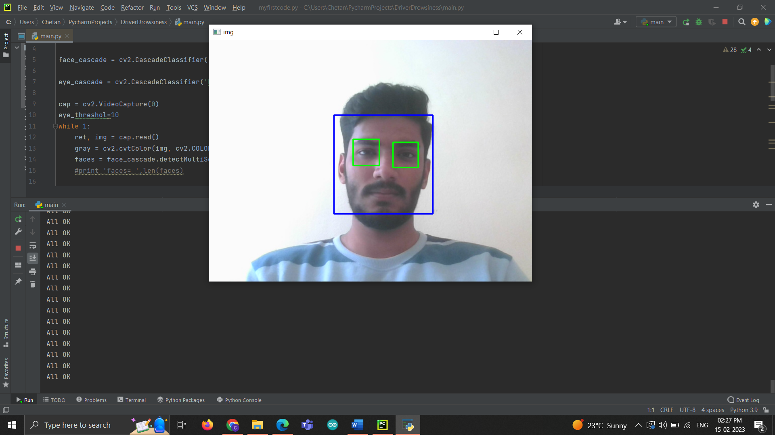
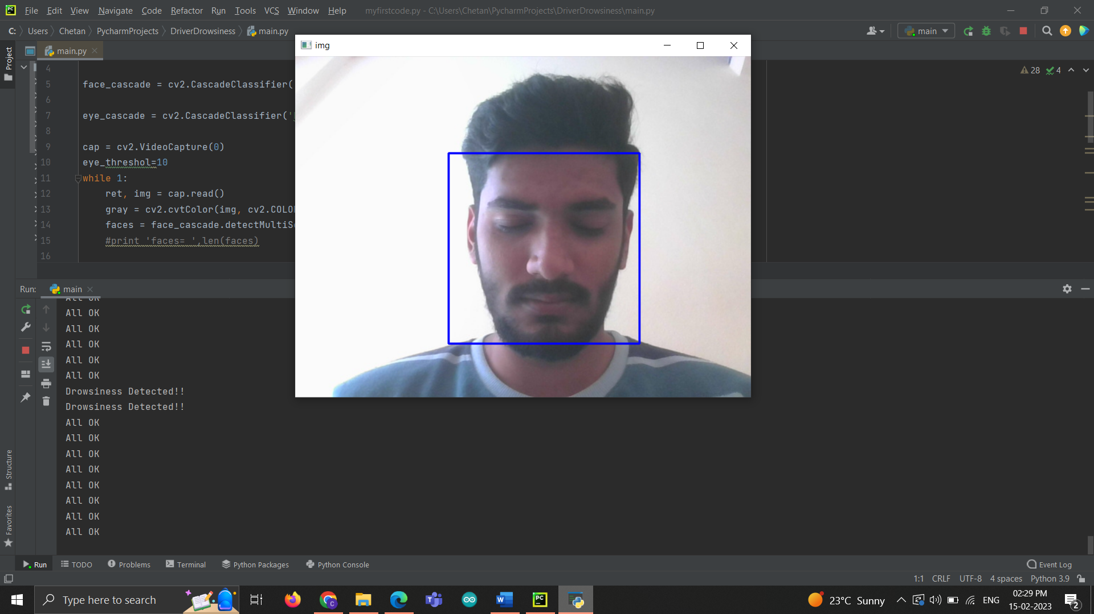
RESULT
Fig. when the subject is awake.
Fig. When the subject eyes are closed

Slide 26
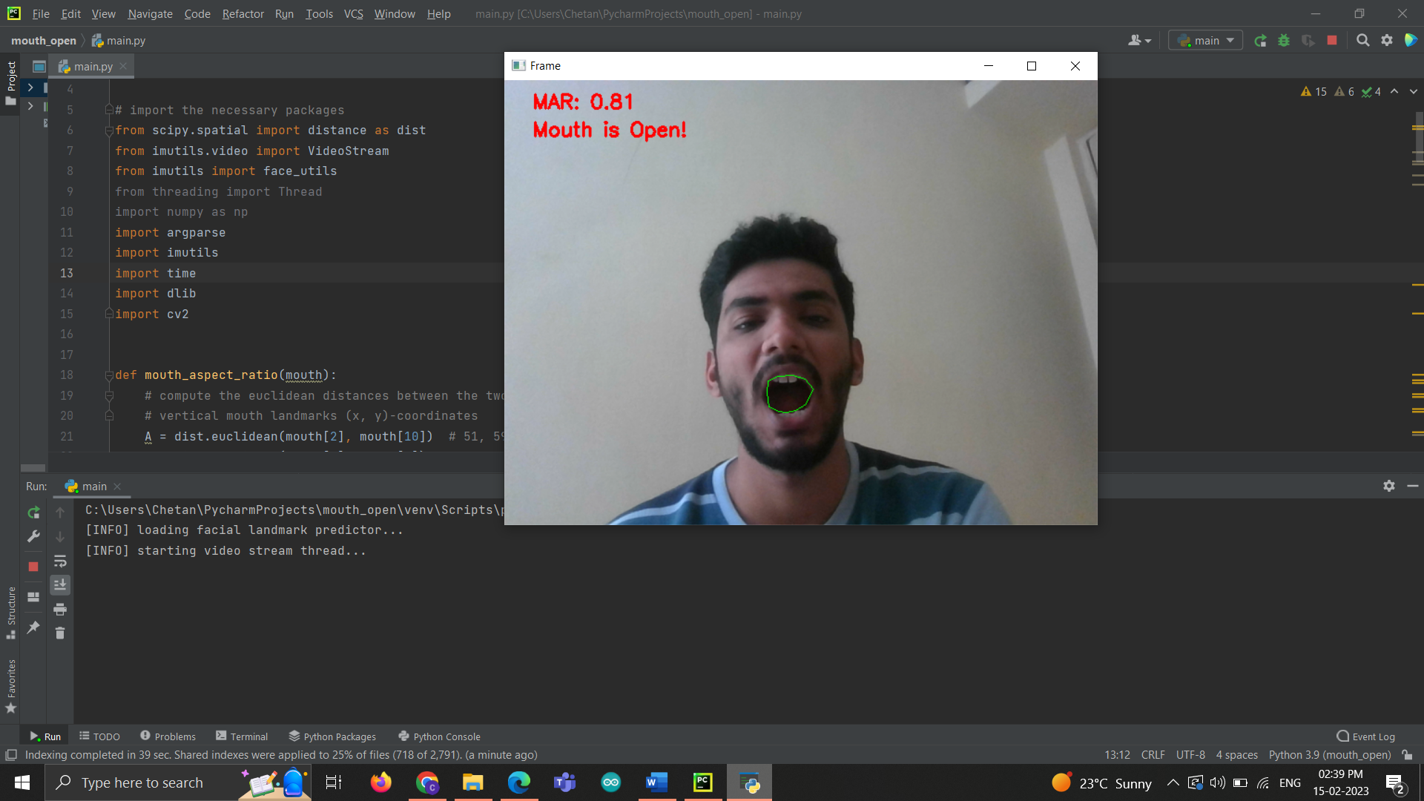
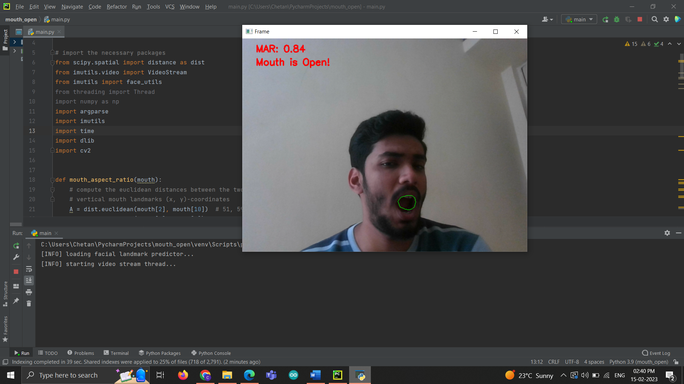
Fig. When the subject's mouth is open
Fig. When the subject's mouth is open in different direction.
.

Slide 27
ADVANTAGES
• The detected abnormal behavior is corrected through alarms in real time.
• Life of the driver can be saved by alerting him using the alarm system.
• Speed of the vehicle can be controlled.
• Traffic management can be maintained by reducing accidents.

Slide 28
DISADVANTAGE & APPLICATIONS
DISADVANTAGE:-
•The system fails if the automobile driver is wearing any kind
of sunglasses.
APPLICATION:-
Driver drowsiness detection is a car safety technology which helps prevent accidents caused by the driver getting drowsy. Various studies have suggested that around 20% of all road accidents are fatigue-related, up to 50% on certain roads.

Slide 29
CONCLUSIONS
The proposed system will analyze the real-time video sequence and it has a high operation speed.
The system is fast and once it starts capturing frames it will continuously detect the face and performs detection till it is stopped.
In the future, a system can be added to vehicle to slow down the vehicle and park it over the side of the road. Drowsiness detection ensures the safety of the driver, co-passengers, and goods.

Slide 30
Future Scope
The future works may focus on the utilization of outer factors such as vehicle states, sleeping hours, weather conditions, mechanical data, etc, for fatigue measurement.
In future it can implement drowsiness detection system in aircraft in order to alert pilot.
In future it can implement drowsiness detection system in schools and colleges to alert the staffs to find the drowsy student in class.

Slide 31
REFERENCES
[1]Pooja D.C.1, Sara Aziz2, Shakuntala Koujalagi3, Shilpa B. H.4, Mr. Vasanth Kumar ,“Diver Drowsiness Detection Using Open CV and Raspberry Pi”,N.T.5, ISSN: 2321-9653; Volume 10 Issue VII July 2022.
[2]Fouzia, Roopalakshmi R, Jayantkumar A Rathod, Ashwitha S Shetty, Supriya k, “Driver Drowsiness”Detection System Based on Visual Features” ,IEEE Catalog Number: CFP18BAC-POD,ISBN: 978-1-5386-1975-9 published April 2018.
[3]Mahek Jain, Bhavya Bhagerathi, Sowmyarani C N, “Real-Time Driver Drowsiness Detection using Computer Vision”, ISSN: 2249-8958 (Online), Volume-11 Issue-1, October 20212021.
[4]Tejashwini N, Chinna T, Deepthi R S, Swathi S, Vijayashree, “Drowsy Driving Detection System IOT Perspective” , pices, vol. 4, no. 8, pp. 203-209, Dec. 2020.
[5]Wisaroot Tipprasert, Theekapun Charoenpong, Chamaporn Chianrabutra, Chamaiporn Sukjamsri,”A Method of Driver’s Eyes Closure and Yawning Detection for Drowsiness Analysis by Infrared Camera” ISSN: 2277-3878 (Online), Volume-8 Issue-4, November 2019 .

Slide 32
REFERENCES
[6]Adnan Shaikh, Rizwan Memon, Asif Lohar, Shiburaj Pappu “Driver Drowsiness Detection System Using Haar Cascade Algorithm”, Volume 9 Issue 4 2022.
[7]Sangivalasa, Bheemunipatnam Mandal, Visakhapatnam (A.P) –531162 2019-2020 ,“Automated Driver Driver Drowsiness Detection For Non 2 Wheelers” (A.P) –531162 2019-2022.
[8]Muhamad Razman, Hikmat Ullahkhan , Shahid Mahmood Awan , Amina Ismail , Mahwish Ilyas, And Ahasan Mahmood , “A Survey on State-of-the-Art Drowsiness Detection Techniques”, IEEE Access Volume 7 DOI: 10.1109/ACCESS.2019.29143732019.
[9]R. Grace, V. E. Byrne, D. M. Bierman, J.-M. Legrand, D. Gricourt, B. Davis, et al., "A drowsy driver detection system for heavy vehicles," in Digital Avionics Systems Conference, 1998. Proceedings.17th DASC. The AIAA/IEEE/SAE, 1998, pp.I36/1 -I36/8 vol. 2.
[10]Shruti Mohanty, Shruti V Hegde, Supriya Prasad, J. Manikandan ,“Design of Real-Time DrowsinessDetection System using Dlib”, 2019 5th IEEE International WIE Conference on Electrical and Computer Engineering, 15-16 Nov 2019, Bangalore, India.

Slide 33
PHASE WISE PLAN
Sr. No | Activity | Date | Remarks
1. | Registration of Project Groups | 18 July 2022
2. | Finalization of Project Guide | 19 July 2022
3. | Reporting to Respective Project Guides | 22July 2022
4. | Discussion of Project idea /Topics (At least 3) | 25 July 2022
5. | Submission of Abstract and Synopsis to project Guides and Project Coordinator in Prescribed Format | 23 September 2022
6. | Literature Survey ( At least 10 IEEE or similar Papers) | 3 October 2022
7. | Presentation on Selected Topic in front of committee members (Ist Presentation) | 17 October 2022
8. | Presentation on Selected Topic in front of committee members (Presentation-II) | 6 February 2022

Slide 34
PHASE WISE PLAN
Sr. No | Activity | Date | Remarks
9. | Presentation on Project Topic in front of committee members (Presentation-III) | 24 April 2023
10. | Presentation on Project Topic in front of committee members (Presentation-IV) | 3 May 2023
11. | Submission of Draft Copy of Project Report to Project Guide. | 23 April 2023
12. | Preparation of survey paper based on project topic | 20 April 2023
13. | Project Exhibition by all Groups and Evaluation | 27 April 2023
14. | Submission of Project Report and Project Book. | 26 May 2023

Slide 35
THANK YOU

